Slide 1
Comprehensive Care of Older People in Country Health Hospitals
(Please insert the document’s classification in the footer – Arial-10pt and in the Properties of this document)
NOTE: If this document is PUBLIC delete this footer. Public label to appear once only.
Confidentiality (caveat if required)-I#-A#

Slide 2
Comprehensive Care of the Older Person - prevents delirium and enhances care for those with CI
People with cognitive impairment admitted to hospital have a significantly increased risk of preventable complications, like delirium, falls and pressure injuries.
People with cognitive impairment may also experience distress in unfamiliar and busy environments.
Although cognitive impairment is a common condition experienced by people in health service organisations, it is often not detected, or is dismissed or misdiagnosed.
Notes:
1. Increased risk of preventable complications such as falls, pressure injuries, delirium and failure to return to premorbid function, as well as adverse outcomes such as unexpected death, or early and unplanned entry into residential care.

Slide 3
Implementing the CCoOP MoC in CHSA
2018/19 8 hospitals
Port Lincoln, Whyalla, Pt Augusta, Pt Pirie, Riverland General Hospital, Murray bridge, Mt Gambier, Gawler
Emergency department and acute medical wards
Education – clinical and non-clinical staff
Implement the CCoOP MoC key priorities using the Dementia Care in Hospital Program from Ballarat Health Services
SharePoint

Slide 4
Comprehensive Care of Older People – model of care
……….will improve the care of older people (aged 65 and older or 45 and older for Aboriginal or Torres Strait Islander) in South Australian public hospitals. Aligns with National Standard 5.
The project involves implementing five key priorities:
Optimising the care that is provided to older people in the Emergency Department (ED), including that delivered in the lead-up to and ED presentation
Improving the standard of hospital care delivered to older people with cognitive impairment
Creating a document for a patient to take home at the time of hospital discharge ‘ You are leaving hospital’
Maximising the discharge summary completion rate
Collection and dissemination of timely, relevant and accurate performance data to the teams providing care through the use of key performance indicators.
Notes:
CCOP addresses part of this section of the standard

Slide 5
Why it matters?
Michael's Story
Highlight Michael’s Story- right click – open hyperlink
Part 1
Part 2
Michael is the father of four children aged 17 to 25, all of whom live at home.
Working as a criminal barrister, Michael was diagnosed with early onset Alzheimer’s disease at the age of 49. Three years on and still in the early stages of his condition, Michael retains insight and articulately shares his thoughts and feelings from within the disease.
Michael’s story is from The Long Goodbye which was aired earlier this year on ABC1. If you would like a copy of the film please visit Ronin Films.

Slide 6
Priority 1
Encouraging appropriate use of emergency departments and identifying alternatives to hospital admission where appropriate.
Screen for Cognitive Impairment using the 4AT
With patient/carer/family/SDM consent use of the Cognitive Impairment Identifier
Optimise the environment
Referral pathways

Slide 7
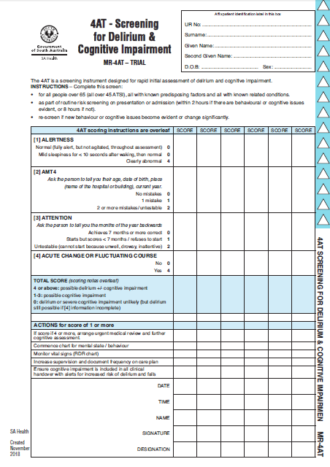
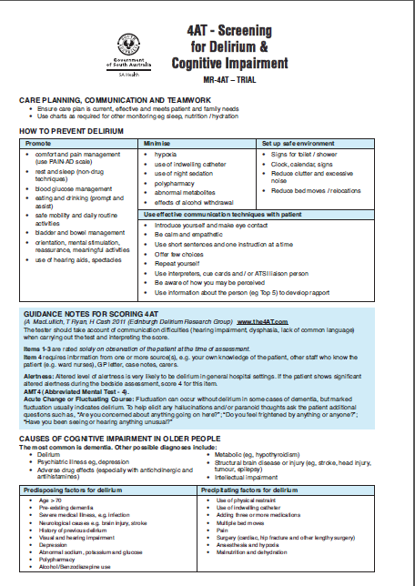
4AT – Screening Tool

Slide 8
4AT
Score of 1-3 indicates CI
Score of 4+ positive for delirium
With patient/carer/family/SDM consent use of the Cognitive Impairment Identifier

Slide 9
Priority 2
Developing standards of care for patients with cognitive impairment.
CHSA Cognitive Impairment Guideline
EBP delirium management
Best practice heath service provision for patient with Dementia
Also during acute admission if identified with CI with patient/carer/family/SDM consent use of the Cognitive Impairment Identifier

Slide 10
Priority 3
Creating a discharge information brochure for patients to take home at the time of discharge. ‘You Are Leaving Hospital’

Slide 11
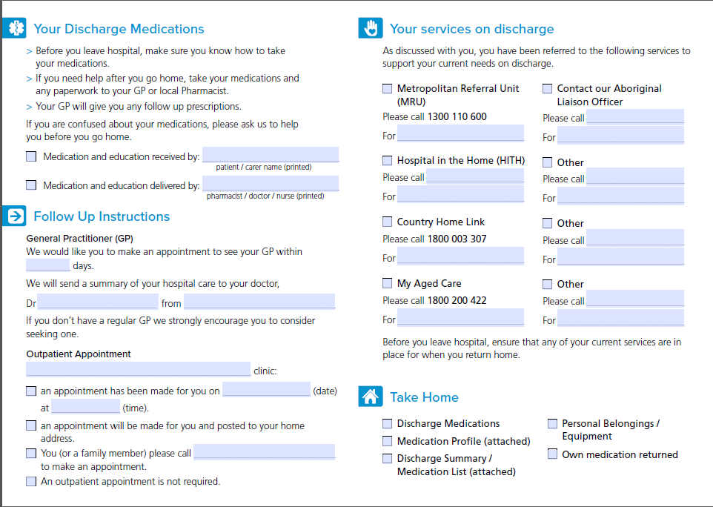

Slide 12
Priority 4
Maximising discharge summary rates.
Improving discharge summary completion and distribution optimises:
Care across transitions
Health outcomes
Reduces risk of readmissions

Slide 13
Priority 5
Collecting and disseminating timely, relevant and accurate performance data to ensure continuous quality improvement.
Data to include:
28 day readmission
Hospital acquired condition
Relative Stay Index
Length of Stay
Discharge to Aged Care

Slide 14
Cognitive Impairment Identifier
The CII was developed by the Alzheimer's community. Those living with Dementia and their carers/family.
They saw it as important that health service staff could see their specific needs at a glance and this supported the delivery of health care that met the individuals needs.
It is not a label to go on the person but a indicator to inform care. Like ‘nil by mouth’ or ‘requires 1 assist to mobilise’

Slide 15
Cognitive Impairment Identifier
What does this mean?
The patient with this symbol on the wall above their bed or on the end of the bed has a cognitive impairment
The patient and/or carer, family, substitute decision maker have consented to the use of the CII
All staff clinical and non-clinical can improve how we interact and provide the best health care for this patient knowing this

Slide 16
Cognitive Impairment Identifier
How can we improve our care?
Introduce yourself each time you go in their room
Make sure you have eye contact when you are speaking with them
Remain calm and talk in a matter of fact way – keep things uncomplicated, reassure, kindness
Involve carers - if they are in the room with you
Focus on one instruction at a time if your asking them something
Give time for responses
You might need to repeat yourself… don’t assume you have been understood
Do not give too many choices

Slide 17
Dignity in Care Principles
Zero tolerance of all forms of abuse.
Support people with the same respect you would want for yourself or a member of your family.
Treat each person as an individual by offering personalised service.
Enable people to maintain the maximum possible level of independence, choice and control.
Listen and support people to express their needs and wants.
Respect people’s privacy.
Ensure people feel able to complain without fear of retribution.
Engage with family members and carers as care partners.
Assist people to maintain confidence and a positive self-esteem.
Act to alleviate people’s loneliness and isolation.

Slide 18
Comprehensive Care of Older People
We all have a role in making a difference.
What you do counts.
Thank You

